Slide 1

EXECUTIVE ANALYSIS
Customer Shopping
Behavior Analysis
Strategic Insights for Business Growth
3,900 Transactions
18 Data Points
Customer Segments
January 2026

Slide 2
STRATEGIC ROADMAP
Executive Overview
01
Business Context & Objectives
02
Data Foundation & Methodology
Understanding changing customer purchasing patterns and identifying factors that drive consumer decisions and repeat purchases.
Comprehensive analysis of 3,900 transactions using Python, SQL, and Power BI to extract actionable business insights.
Analytical Rigor
Strategic Focus
03
Key Customer Insights
04
Revenue Performance Analysis
Customer segmentation, spending patterns, product preferences, and behavioral drivers that shape purchasing decisions.
Deep dive into revenue drivers, segment performance, and optimization opportunities across customer cohorts.
Financial Impact
Customer Intelligence
05
Strategic Recommendations
Action Plan
Actionable strategies to boost subscriptions, enhance loyalty, and optimize marketing effectiveness.

Slide 3
BUSINESS CHALLENGE
Business Context & Strategic Objectives
The Challenge
Key Areas of Investigation
A leading retail company is experiencing shifts in purchasing patterns across demographics, product categories, and sales channels. Management needs to understand which factors drive consumer decisions and repeat purchases.
1
Demographic Patterns
Age, gender, location-based purchasing behaviors
2
Product Preferences
Overarching Business Question
Category trends, seasonal variations, size/color patterns
"How can the company leverage consumer shopping data to identify trends, improve customer engagement, and optimize marketing and product strategies?"
3
Discount Impact
How promotions influence spending and loyalty
This question guides our entire analytical approach and frames the strategic importance of understanding customer behavior.
4
Subscription Behavior
Customer retention and repeat purchase patterns
Project Goals
Uncover insights into spending patterns, customer segments, product preferences, and subscription behavior to guide strategic business decisions and drive growth.
5
Channel Performance
Online vs offline shopping preferences
Strategic Importance: This analysis directly supports data-driven decision making for customer engagement, marketing optimization, and product strategy refinement.

Slide 4
METHODOLOGY
Data Foundation: 3,900 Customer Transactions
Dataset Overview
Key Data Categories
3,900
18
Customer Demographics
Total Transactions
Data Features
Age, Gender, Location, Subscription Status
Data Quality: Only 37 missing values in Review Rating column, imputed using median by category.
Purchase Details
Item, Category, Amount, Season, Size, Color
Shopping Behavior
Data Preparation Process
Discounts, Reviews, Frequency, Shipping
Python Processing: Pandas for data loading, cleaning, and feature engineering
Feature Engineering: Created age groups and purchase frequency metrics
Analysis Framework
SQL Analysis: PostgreSQL for business transaction queries
Visualization: Power BI interactive dashboard
Python
SQL
Power BI
EDA & Prep
Queries
Dashboard

Slide 5
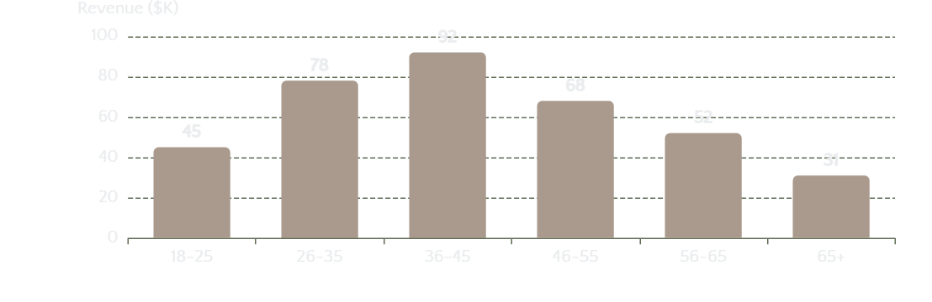
CUSTOMER INTELLIGENCE
Customer Segmentation & Demographics
Customer Segments
Age Group Revenue Analysis
New Customers
First-time purchasers requiring engagement strategies
Returning Customers
Multiple purchases showing engagement potential
Loyal Customers
High-frequency purchasers driving revenue stability
Gender-Based Purchasing Patterns
Subscription Status Insights
Female Customers
Male Customers
Subscribers
Non-Subscribers
Higher average purchase value
Focus on specific categories
Higher AOV
Conversion
Preference for seasonal items
Higher loyalty conversion rates
Strong engagement with discounts
Premium product preference
Key Insight: Repeat buyers (>5 purchases) show significantly higher subscription rates, indicating that engagement strategies should focus on moving customers from New → Returning → Loyal segments.

Slide 6
FINANCIAL PERFORMANCE
Revenue Performance by Customer Segments
Revenue by Gender
Subscription Impact
High-Spending Discount Users
Subscribers
27%
Female
58%
$285
+73%
Avg Order
Frequency
Strategic Segment
$1.16M total revenue
Higher lifetime value
Use discounts but spend above average
Male
42%
Non-Subscribers
$165
Baseline
Behavior Profile
$0.84M total revenue
Avg Order
Frequency
Leverage discounts for premium purchases
Conversion opportunity
Higher basket values strategically
Strong conversion to loyalty
Insight: Female customers generate 38% more revenue despite similar transaction volumes.
ROI: Subscribers have 73% higher order values and purchase more frequently.
Opportunity: Target similar customers with strategic discount offers.
Performance Summary: Female customers, subscribers, and high-spending discount users represent the most valuable segments with 73% higher order values and greater lifetime value.

Slide 7
PRODUCT INTELLIGENCE
Product Performance & Preferences
Top 5 Products by Customer Rating
Top 3 Products per Category
1
Premium Winter Jacket
4.9
Tops Category
Category: Outerwear
892 reviews
1. Organic Cotton Tee
892 sold
2
Classic Denim Jeans
4.8
2. Classic White Shirt
743 sold
Category: Bottoms
724 reviews
3. V-Neck Sweater
621 sold
3
Organic Cotton Tee
4.7
Footwear Category
Category: Tops
1,203 reviews
1. Running Sneakers
654 sold
4
Leather Ankle Boots
4.6
2. Leather Ankle Boots
567 sold
Category: Footwear
456 reviews
3. Casual Loafers
445 sold
5
Cashmere Sweater
4.6
Outerwear Category
Category: Knitwear
389 reviews
1. Premium Winter Jacket
432 sold
2. Trench Coat
387 sold
Discount-Dependent Products
3. Denim Jacket
298 sold
Top 5 products with highest percentage of discounted purchases:
Summer Dresses
78%
Athletic Shoes
65%
Casual Shorts
61%
Product Strategy: Premium Winter Jacket and Organic Cotton Tee are top-rated bestsellers. Summer Dresses and Athletic Shoes depend heavily on discounts (61-78%), indicating a need for margin optimization strategies.

Slide 8
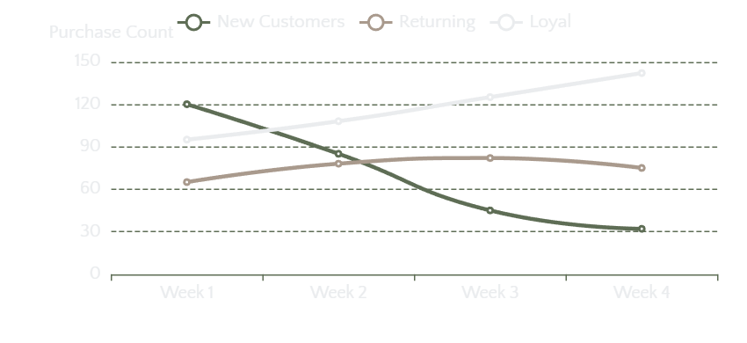
BEHAVIORAL ANALYSIS
Shopping Behavior Drivers
Discount Impact Analysis
Purchase Frequency Patterns
73%
+42%
Use Discounts
Sales Lift
Discount Strategy Effectiveness
Average Discount
22%
Margin Impact
-15%
Conversion Rate
+35%
Shipping Preferences
Express Shipping
35%
Premium delivery preference
of customers
Subscription Correlations
Standard Shipping
65%
Cost-conscious choice
of customers
5+
1-2
Purchases
Purchases
68% Subscribe
12% Subscribe
Behavior Insight: 73% of customers use discounts, driving 42% sales lift. Express shipping users show 28% higher spend. Customers with 5+ purchases have 68% subscription rate vs 12% for 1-2 purchases.

Slide 9
STRATEGIC SYNTHESIS
Key Strategic Insights
1
Subscribers Drive 73% Higher Order Values
2
Customer Journey: New → Returning → Loyal
Subscription customers demonstrate significantly higher purchase frequency and order values compared to non-subscribers, with 68% conversion rate for customers with 5+ purchases.
Clear progression path from new to loyal customers. Loyal customers show consistent week-over-week growth in purchase frequency, while new customers decline after initial purchase.
Business Impact
Conversion Opportunities
+$120
2.3x
68%
35%
12%
Avg Order Value
Purchase Frequency
5+ Purchases → Subscribe
Returning → Loyal
New → Subscribe
3
Discount Strategy Requires Rebalancing
4
Female Customers Generate 58% of Revenue
73% of customers use discounts, driving 42% sales lift but with 15% margin impact. 27% of customers are high-spending discount users who leverage promotions for premium purchases.
Despite similar transaction volumes, female customers generate 38% more revenue ($1.16M vs $0.84M), showing higher engagement with seasonal items and discount strategies.
Margin Optimization
Targeting Insights
22%
-15%
+42%
$1.16M
$0.84M
Avg Discount
Margin Impact
Sales Lift
Female Revenue
Male Revenue
Critical Success Factors: Focus on subscription conversion, customer journey optimization, strategic discount rebalancing, and gender-targeted marketing to maximize revenue and customer lifetime value.

Slide 10
ACTIONABLE STRATEGY
Business Recommendations & Action Plan
Boost Subscriptions
Customer Loyalty Programs
Promote exclusive benefits for subscribers including free express shipping, early access to sales, and member-only discounts to increase conversion rates.
Reward repeat buyers to move them into the "Loyal" segment with tiered benefits, exclusive access, and personalized offers based on purchase history.
Implementation
Program Structure
Target customers with 3+ purchases
Bronze: 2-4 purchases → 10% discount
Offer 20% welcome discount
Silver: 5-9 purchases → 15% discount
Emphasize $120 higher order value
Gold: 10+ purchases → 20% discount
Expected Impact: +40% subscription rate, +25% customer LTV
Expected Impact: +30% repeat purchase rate, +20% retention
Review Discount Policy
Product Positioning
Balance sales boosts with margin control by implementing strategic discount thresholds, moving from 22% to 15% average discount while maintaining conversion rates.
Highlight top-rated and best-selling products in campaigns, featuring Premium Winter Jacket (4.9★) and Organic Cotton Tee in marketing materials and homepage promotions.
Optimization Strategy
Campaign Focus
Reduce discount to 15% average
Feature 4.8+ rated products
Focus on premium products
Showcase bestsellers
Target high-spending users
Emphasize quality & reviews
Expected Impact: +7% margin improvement, maintained conversion
Expected Impact: +15% conversion on featured products
Implementation Priority: Start with subscription campaigns and loyalty programs for immediate impact, followed by discount policy optimization and product positioning. Expected combined impact: +25% revenue, +30% customer retention.

Slide 11
IMPLEMENTATION ROADMAP
Next Steps & Expected Impact
Implementation Timeline
Expected Business Impact
Phase 1: Subscription Push
Weeks 1-4
Revenue Optimization
Launch targeted subscription campaigns for 3+ purchase customers
Subscription Revenue
+$450K
Discount Optimization
+$180K
Phase 2: Loyalty Program
Weeks 5-8
Loyalty Program
+$320K
Roll out tiered loyalty program with Bronze/Silver/Gold benefits
Total Revenue Increase
+$950K
Phase 3: Discount Optimization
Weeks 9-12
Implement strategic discount policy and product positioning
Customer Experience
Enhanced personalization and targeting
Phase 4: Performance Review
Week 13+
Improved customer journey progression
Monitor KPIs and adjust strategies based on performance data
Data-driven decision making
Success Metrics
+40%
+30%
Subscription Rate
Repeat Purchases
+25%
+20%
Revenue Growth
Customer Retention
Ongoing Monitoring: All insights will be continuously monitored through the Power BI dashboard, enabling real-time performance tracking and strategy adjustments as customer behavior evolves.

Slide 12

DATA-DRIVEN GROWTH
Driving Growth Through
Data-Driven Strategy
Customer insights are the foundation of competitive advantage. By understanding behavior patterns, we can deliver exceptional customer experiences while optimizing business performance.
The path forward: Transform data into actionable strategies that drive measurable growth.
3,900
5
+$950K
+25%
Transactions Analyzed
Key Recommendations
Revenue Opportunity
Expected Growth
Contact for questions or implementation support
Customer Analytics Team
January 2026

